Slide 1
TMI Dose Data
2022 Unit 1 Dose and Hours Only
ISFSI Total Project Chart

Slide 2
Dose and Hours Data

Slide 3
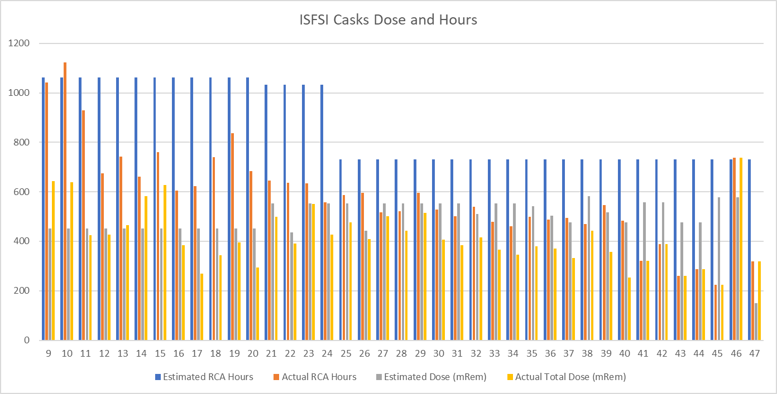
ISFSI Total Project Chart

